Slide 1
Communication
Message Passing
Remote procedure call
Distributed Operating systems – Concepts and Design by Pradeep K. Sinha

Slide 2
2. MESSAGE PASSING
Reference: Chapter 3
Distributed Operating systems – Concepts and Design by Pradeep K. Sinha

Slide 3
2.1 Introduction
Communication between two computers on a distributed system refers to communication between processes running on these computers. E.g. Resource manager processes on individual computers. A distributed operating system will therefore need to provide for Interprocess Communication (IPC) mechanisms to facilitate such communication activities. For IPC to take place, information sharing between the two processes is required and takes two forms:

Slide 4
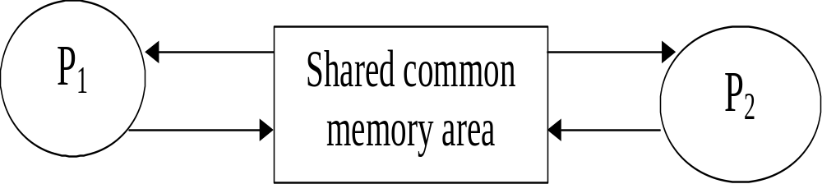
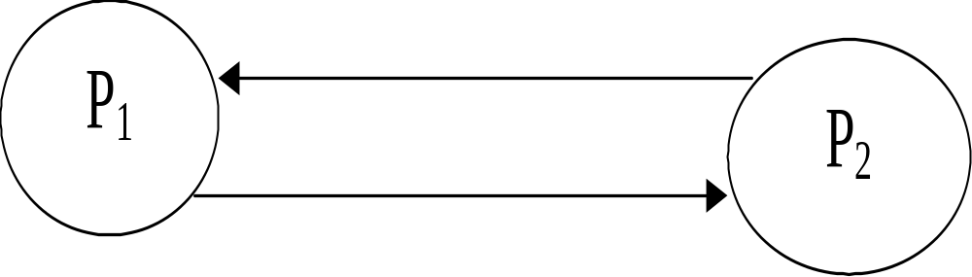
2.1 Introduction
Original Sharing – shared data approach
Copy sharing – message-passing

Slide 5
2.1 Introduction
Computers in a distributed system do not share memory and therefore message passing is the basic IPC (inter process communication) mechanism. The communicating processes communicate directly with each other.
A message-passing system is a subsystem of a distributed operating system that provides a set of message-based IPC protocols and does so by shielding the details of complex network protocols and multiple heterogeneous platforms from programmers. All programmers therefore need to write are program that use simple communication primitives such send, receive etc.

Slide 6
2.2 Desired Features of A Good Message-Passing System
Simplicity – simple and easy to use
Uniform Semantics – for both local and remote communication
Efficiency – by reducing the number of message exchanges during the communication process
Reliability – should cope with failure problems and guarantee the delivery of a message.
Correctness – occurs when there is need for a sender to send to several receivers and a receiver to receive from several senders. Issues such as atomicity, ordered delivery and survivability are addressed.
Flexibility – to suite different applications with different requirements
Security – should provide secure end-to-end communication
Portability – both the message passing system and the applications written by using the primitives of the IPC protocols of the message passing.

Slide 7
2.3 Issues in IPC Message Passing
A message is a block of information formatted by a sending process in manner that it is meaningful to the receiving process. It is made up of:
A fixed length header with 3 parts:
Address – of the sending and receiving processes
Sequence number – message ID (useful incases of losses or duplications)
Structural information – the type (data or pointer to data included) and the length of the message
A variable size collection of typed data objects

Slide 8
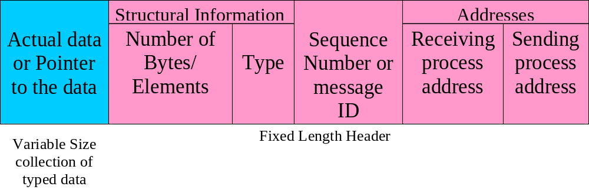
2.3 Issues in IPC Message Passing
Typical Message Structure

Slide 9
2.3 Issues in IPC Message Passing
Issues to be addressed
Who is the sender?
(ii) Who is the receiver?
(iii) Is there one receiver or many receivers?
(iv) Is the message guaranteed to have been accepted by the receiver(s)?
(v) Does the sender need to wait for reply?

Slide 10
Issues to be addressed:
What should be done if a catastrophic event such as a node crash or a communication link failure occurs during the course of communication?
What should be done if the receiver is not ready to accept the message: will the message be discarded or stored in a buffer? In the case of buffering, what should be done if the buffer is full?
If there are several outstanding messages for a receiver, can it choose the order which to service the outstanding messages?

Slide 11
2.4 Synchronization
2 Semantics:
Blocking Semantics - their invocation blocks the execution of their invoker.
  On send, the sending process is blocked until the receiver acknowledges and on receive, the receiving process is blocked until the message is received. (Called Synchronous communication)
Non-Blocking Semantics – their invocation does not block the execution of their invoker
  On send, the sending process is allowed to proceed and on receive, the receiving process proceeds and returns control almost immediately. (Called Asynchronous communication)

Slide 12
Non-Blocking Semantics
How does the receiving process know that he message has arrived in the buffer?
Polling – using a test primitive to test the buffer status
Interrupt – a software interrupt to the receiving process is issued once the message has filled the buffer and it is ready for use by the process

Slide 13
2.5 Buffering
Null Buffer (No Buffering)
  No place to temporary store the message
  The message remains in the sender’s address space until the sender is ready or the message is simple discarded
Single Message Buffer
  A buffer with capacity to store a single message
Unbounded-Capacity Buffer
  To receive all the un-received messages
  Practically impossible
Finite-Bound (or Multiple-Message Buffer)
  Need to address buffer overflow

Slide 14
2.6 Multidatagram Messages
Remember Maximum-Transfer-Unit (MTU) of network? The maximum data size that can be transmitted
Each fragment of a message is put into a packet called datagram
Single-datagram messages vs. multidatagram messages
Disassembling and reassembling of multidatagram messages is usually handled by the message-passing system. Encoding (into a stream form) and decoding of the message is carried out for easy transmission

Slide 15
2.7 Process Addressing
Addressing (or naming) of the parties (sender and receiver)
Explicit Addressing – the process is explicitly named as a parameter
Implicit Addressing – the process name is not supplied
Functional addressing – when a the primitive used identifies a service (c below rather than a process)

Slide 16
2.7 Process Addressing
Examples:
Send(process_id, message) – send a message to the process identified by “process_id”
Receive(process_id, message) – receive a message from the process identified by “process_id”
Send_any(service_id, message) – send a message to any process that provides the service of type “service_id”
Receive(process_id, message) – receive a message from any process and return the process identifier of the process from which the message was received.

Slide 17
2.7 Process Addressing
A simple way to identify a process is by use of the machine_id and the local_id (process identifier or port identifier)
  This does not require global coordination (an advantage)
  Does not allow processes to migrate to other machines (a drawback)
Another method is link-based process address with 3 fields:
  Machine_id – where the process is created
  Local_id – local id of the process generated at the machine where it is created
  Machine_id – last known location of the process

Slide 18
2.8 Failure Handling
  Failures during IPC may lead to:
    Loss of request message – the communication link has failed or the receiver is down
    Loss of response message – the communication link has failed or the sender is down
    Unsuccessful execution of the request – receiver crashes while the request is being processed
  These are addressed by designing a reliable IPC protocol based on the idea of internal retransmissions of messages after timeouts and the return acknowledgement message to the sender by the receiver

Slide 19
Semantics for reliable IPC protocol
Four-Message Reliable IPC protocol
  The client sends a message to the server
  The kernel of the server returns an acknowledgement message.
  The server returns reply message
  The client sends an acknowledgement message

Slide 20
Semantics for reliable IPC protocol
Three-Message Reliable IPC protocol
  The client sends a message to the server
  The server returns reply message
  The client sends an acknowledgement message
  A problem if a request processing takes a long time and this may be interpreted as ‘lost message’ leading to unnecessary re-transmissions. Use of a timer at the receiver’s can be used to address this problem

Slide 21
Semantics for reliable IPC protocol
Two-Message Reliable IPC protocol
  The client sends a message to the server
  The server returns reply message
  It obeys at-least-once semantics – at least one execution.

Slide 22
Idempotency of Handling of Duplicate Request Messages
Idempotency – “repeatability”
Idempotent operations produces same results without any side effects if repeated, While nonidempotent operations do not necessarily produce the same results
Exactly-once semantics is needed for nonidempotent operations. This can be done by use of a unique id for every request that the client makes and set up a reply cache in the kernel’s address space on the server machine.

Slide 23
Keeping Track of Lost and Out-of-Sequence Packets
Stop-and-wait protocol – acknowledge packet separately. This leads to communication overhead
Blast-protocol – a single acknowledgement for all packets but may fail if a node crashes.
Use of a bitmap – include the total number of packets and the position of each packet in the headers of all packets.

Slide 24
2.10 Group Communication
One-to-many communication
  Multicast communication
  Broadcast – special kind of multicast; message sent to all processors on the n/w
  Group Management
    Closed (only a member of the group can send a message to the group) or open groups
    Use of group server process to allow dynamic addition, deletion of group members and creation of the groups too. The server may however become a bottleneck.
  Group Addressing
    High-level (ASCII Strings) or Low-level (multicast address)

Slide 25
2.10 Group Communication
Many-to-one communication
  Selective vs. nonselective receiver
Many-to-Many Communication
  All Issues that apply to both one-to-many and many-to-one communication apply here
  The issue of ordered message delivery arises. Mechanisms used include: Absolute, consistent ordering, causal ordering, among others

Slide 26
Exercise
The socket-based IPC of the 4.3bsd UNIX system illustrates how message-passing system can be designed using the concepts and mechanisms presented in this chapter. Study the case and make notes for yourselves…
Try to make use of the internet for the notes

